Slide 1
NN Kernels
Sergio Zerpa
DES SDF FW

Slide 2
Content
AIFORDES Overview
TensorFlow Lite for Microcontrollers (TFL Micro)
TFL Micro
Components
Software architecture
Development flow
Trained model
Quantization
TFL Micro – NN Kernels optimizations
CMSIS NN –
Overview
Integration with TFL micro
An alternative approach for RiscV?
More info

Slide 3
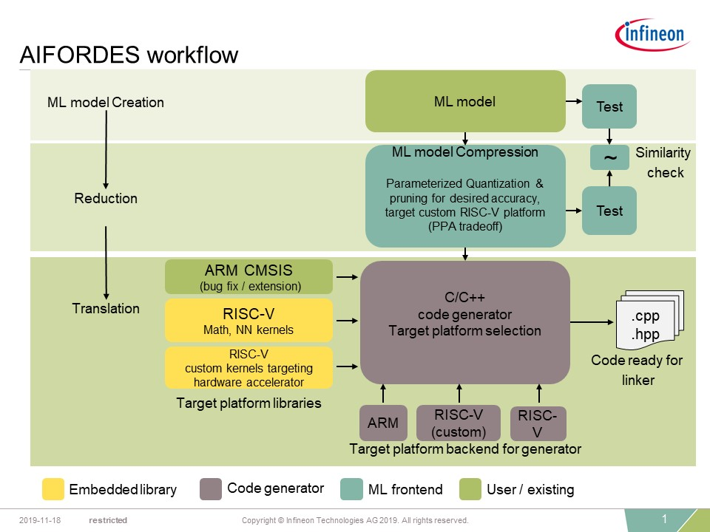
Overview: AIFORDES workflow
Next step:
Run on
Embedded
Target
(Inference)

Slide 4
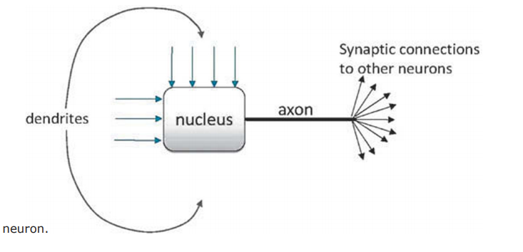
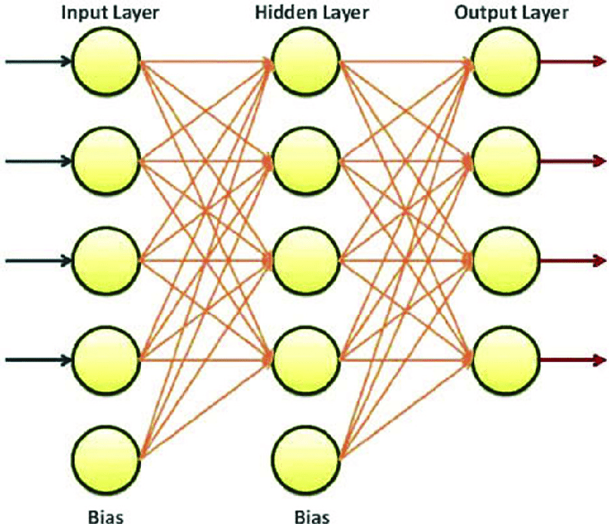
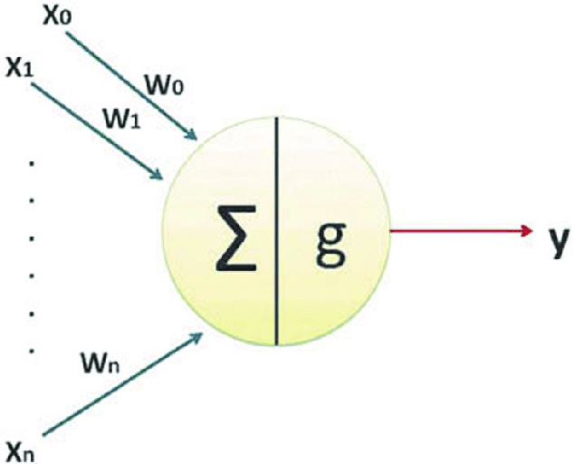

Overview: Neural networks
x1
y1
x2
y2
x3
y3
x4
y4
Training: structure of network (interconnections, nodes, weights, etc.)
Main challenge:
Generation of optimized models
Accuracy of output
Inference: calculating output for a given input
Main challenge:
Number of arithmetic operations
Restricted memory for model and calculations

Slide 5
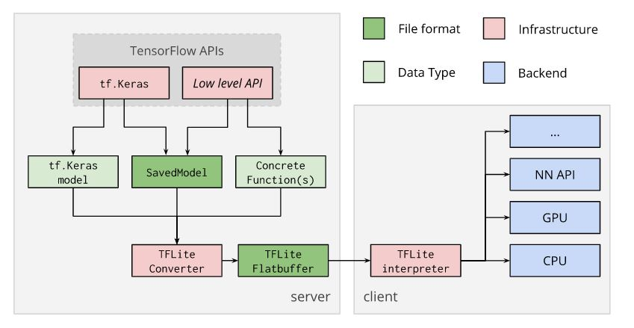
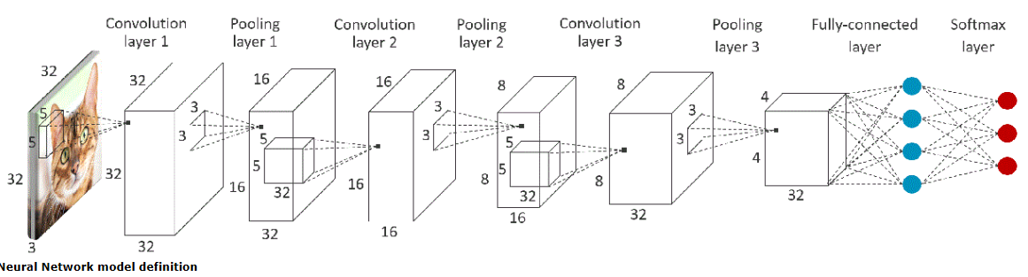
Tensor Flow Lite for Microcontrollers (TFL Micro)
Training/generating a model
Running inference

Slide 6
TFL Micro – Components
The Model:
The interpreter:
Focus: The interpreter performs inference to compute the output for new-inputs. It uses NN Kernels such as:
Fully-connected layers
Convolution layers
Pooling layers
Softmax-layers
Source-code: aiml_deployment\tensorflow\tensorflow\lite\micro
Main Processor
Trained-model loader
Micro
Interpreter
Output handler
Peripheral Y
Driver
Peripheral Y
Peripheral X
Peripheral X
Driver
Input generator
Error reporter
Peripheral Z
Driver
Peripheral Z
Operations Resolver
Reference kernel
*Platform kernel
Math
(standard lib)
NN-Math
The interpreter sequence:
Load
Trained-model
Init
Prepare
Eval
Invoke (after setting new input)

Slide 7
TFL Micro - Software architecture (Block diagram)
Main Processor
Micro
Interpreter
Peripheral Y
Trained-model loader
Output handler
Peripheral Y
Driver
Peripheral X
Peripheral X
Driver
Input generator
Error reporter
Peripheral Z
Driver
Peripheral Z
Operations Resolver
Reference kernel
*Platform kernel
Math
(standard lib)
NN-Math
*Platform kernel: e.g. CMSIS-NN, optimized versions in TFL, etc.

Slide 8
TFL Micro - Software architecture (Organizational diagram )
Main
Input generator
Generated model loader
Micro Interpreter
Output handler
Operations resolver
Error
reporter
Reference kernel
Platform kernel
Math (standard lib)
NN-Math
Peripheral X
Driver
Peripheral Z
Driver
Peripheral Y
Driver

Slide 9
TFL Micro – Software architecture (Layered diagram)
Micro Interpreter
Application
Generated model loader
Error
reporter
Operations resolver
Input generator
Output handler
Reference kernel
Platform kernel
Peripheral Z
Driver
Peripheral Y
Driver
Peripheral X
Driver
NN-Math
Math
(standard lib)

Slide 10
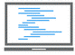
TFL Micro – Development flow (for Host computer)
ML application with trained-model
Development flow for host
Micro Interpreter
Build-Scripts
Operations resolver
Kernel
(Interface)
Builder
Compiler
(gcc)
Debugger
(gdb)
Reference kernel
Executable
(.exe)
Host
Computer
Math
(standard lib)
Host
TensorFlowLite Micro
Microcontroller-device
(e.g. platform includes, linker)

Slide 11
TFL Micro – Development flow (for RiscV ISS)
ML application with trained-model
Development flow for Riscv
Target
Micro Interpreter
Build-Scripts
Operations resolver
Kernel
(Interface)
Builder
Compiler
(riscv)
Debugger
(gdb-client)
Debugger
(gdb-server)
Reference kernel
Optimized kernel for RiscV
Executable
(.elf)
Math
(standard lib)
Math-nn
RiscV
ISS
(SweRV)
Microcontroller device
(RiscV)
Relies on TensorFlowLite-Micro acceptance tests (At interpreter level, and at kernel-level)
Builds within TensorFlowLite-environment
TensorFlowLite Micro
Microcontroller-device
(e.g. platform includes, linker)

Slide 12
TFL Micro - Trained model
x1
y1
x2
y2
x3
y3
x4
y4
Floating point model
All weights are floating point value
More accurate
Required more hardware resources during inference
Simpler arithmetic but more resources
Quantized model
All weights are quantized integer values (32-bits, 16-bits, 8-bits or less)
Less accurate
Required quantization aware training techniques
Required less hardware resources during inference
Arithmetic that requires optimize-ways of doing operations but less resources

Slide 13
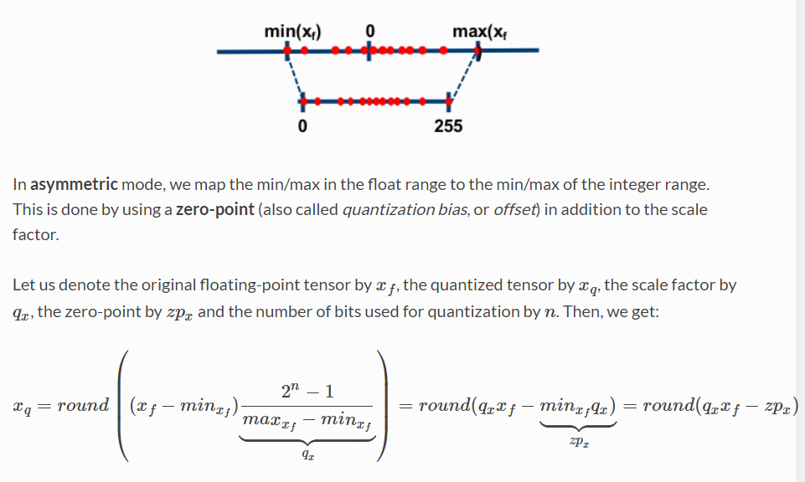
TFL Micro - Trained model (Asymmetric quantization)
Quantization:
real value = (quantized value + zero point) / scale
x_{f} : real value
q_{x}: scale
x_{q}: quantized_value
zp_{x} : zero point
x_{f} = (x_{q} + zp_{x}) / q_{x}
https://nervanasystems.github.io/distiller/algo_quantization.html

Slide 14
TFL Micro - Trained model (Asymmetric quantization)
Quantization - From Float to quantized uint8
255
125
127
129
0
min = -63.5f
max = 64.0f
-1.0f
0.0f
1.0f
Conver float to quantized-uint8:
scale = (2^n – 1) / (max – min) = 2.0f
zeroPoint = min * scale = -127
quantized_value = (real_value * scale) - zeroPoint
Convert a quantized-uint8 back to float:
real_value ~= (quantized_value + zeroPoint) / scale
e.g Converting a number back and forwards:
1.0f -> quantized_value = (real_value * scale) - zeroPoint = (1.0 * 2.0 ) – (-127) = 129
129 -> real_value = (quantized_value + zeroPoint) / scale = (129 + (-127)) / 2.0 = 1.0f

Slide 15
TFL Micro - Trained model (Asymmetric quantization)
Quantization - From Float to quantized int8
127
-3
1
2
3
-1
-128
min = -63.5f
1.0f
max = 64.0f
-1.0f
0.0f
1.5f
2.0f
Conver float to quantized-int8:
scale = (2^n – 1) / (max – min) = 2.0f
zeroPoint = abs(-128) + min * scale = 1
quantized_value = (real_value * scale) - zeroPoint
Convert a quantized-int8 back to float:
real_value ~= (quantized_value + zeroPoint) / scale
e.g Converting a number back and forwards:
1.0f -> quantized_value = (real_value * scale) - zeroPoint = (1.0 * 2.0) - 1 = 1
1 -> real_value = (quantized_value + zeroPoint) / scale = (1 + 1) / 2.0 = 1.0f

Slide 16



TFL Micro - Trained model (Quantization arithmetic)
Consider float values:
a_f, b_f , c_f
Consider its quantized values:
a, b, c
Consider scales A, B and C:
scale_a (Qa), zeroPoint_a (ZPa)
scale_b (Qb), zeroPoint_b (ZPb)
scale_c (Qc), zeroPoint_c (ZPc)
max
a
zeroPoint
min
min
a_f
max
0.0f
Then the float-multiplication can be expressed as:
c_f = a_f * b_f
The associated quantized-multiplication can be expressed as:
$$\left(\frac{c+ZP_{c}}{Q_{c}}\right)=\left(\frac{a+ZP_{a}}{Q_{a}}\right)∗\left(\frac{b+ZP_{b}}{Q_{b}}\right)$$
Therefore:
$$c=\left(\frac{Q_{c}}{Q_{a}∗Q_{b}}\right)∗\left(a+ZP_{a}\right)\left(b+ZP_{b}\right) −ZP_{c}$$
Or:
$$c=Q∗\left(a+ZP_{a}\right)\left(b+ZP_{b}\right) −ZP_{c}$$
where
$$Q=\left(\frac{Q_{c}}{Q_{a}∗Q_{b}}\right)≅\frac{A}{2^{n}}$$
A: is an integer multiplier
n: number of bits to shift after multiplication

Slide 17
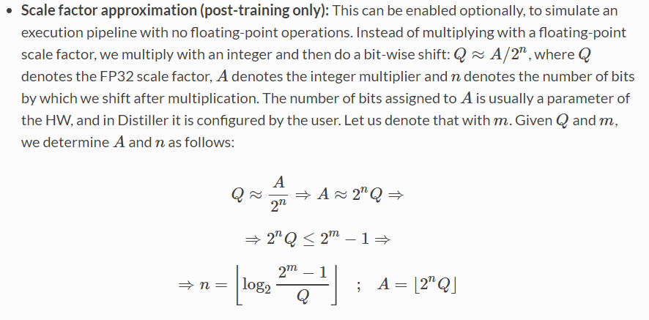
TFL Micro - Trained model (Quantization scaling factor)
https://nervanasystems.github.io/distiller/algo_quantization.html

Slide 18
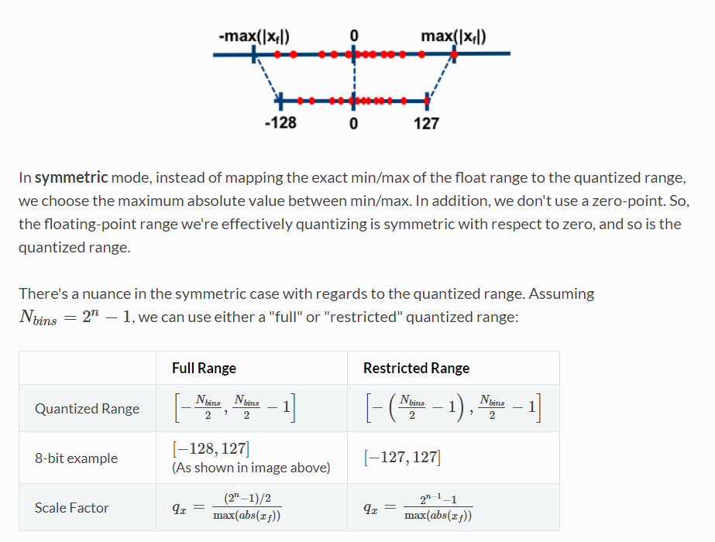
TFL Micro - Trained model (Symmetric quantization)
https://nervanasystems.github.io/distiller/algo_quantization.html

Slide 19

TFL Micro – NN Kernels optimizations Option 1
Micro Interpreter
Main Processor
Operations resolver
Trained-model loader
Micro
Interpreter
Output handler
Peripheral Y
Driver
Peripheral Y
Kernel
(Interface)
Peripheral X
Peripheral X
Driver
Input generator
Error reporter
Peripheral Z
Driver
Peripheral Z
Reference kernel
Optimized kernel
Operations Resolver
Math
(standard lib)
Optimized
Math-nn
Reference kernel
*Platform kernel
Math
(standard lib)
NN-Math
Microcontroller device
Invoke
(after setting new input)
Load
Trained-model
Init
Prepare
Eval
Take advantage of the interpreter‘s Prepare phase to pre-compute factors that depend only on the model and not on the new input.
Prepare:
Pre-calculate factors that only depend on the weights and biases in the model
Allocate memory to store those factors (i.e. this requires extra-memory resources)
Inference:
Calculate factors that depend on new-input
Combine results with the pre-computed factors
$$c=Q∗\left(a+ZP_{a}\right)\left(b+ZP_{b}\right) −ZP_{c}$$
Can be pre-computed,
If value b comes with the model

Slide 20
TFL Micro – NN Kernels optimizations Option 2
Micro Interpreter
Main Processor
Operations resolver
Trained-model loader
Micro
Interpreter
Output handler
Peripheral Y
Driver
Peripheral Y
Kernel
(Interface)
Peripheral X
Peripheral X
Driver
Input generator
Error reporter
Peripheral Z
Driver
Peripheral Z
Reference kernel
Optimized kernel
Operations Resolver
Math
(standard lib)
Optimized
Math-nn
Reference kernel
*Platform kernel
Microcontroller device
Math
(standard lib)
NN-Math
Invoke
(after setting new input)
Load
Trained-model
Init
Prepare
Eval
Introduce an offline-interpreter to pre-compute factors that depend only on the model and not on the new input.
Offline:
Pre-calculate factors that only depend on the weights and biases in the model
Store those factors as meta-data which shall be provide it together with the model.
Extend the interpreter kernel operations to correctly interpret the meta data
Inference:
Perform the operation accordingly, using the model, meta data and new input data.

Slide 21
TFL Micro – NN Kernels optimizations Option 3
Micro Interpreter
Main Processor
Operations resolver
Trained-model loader
Micro
Interpreter
Output handler
Peripheral Y
Driver
Peripheral Y
Kernel
(Interface)
Peripheral X
Peripheral X
Driver
Input generator
Error reporter
Peripheral Z
Driver
Peripheral Z
Reference kernel
Optimized kernel
Operations Resolver
Math
(standard lib)
Optimized
Math-nn
Reference kernel
*Platform kernel
Microcontroller device
Math
(standard lib)
NN-Math
Load
Trained-model
Init
Prepare
Eval
Invoke
(after setting new input)
Take advantage of the sparsity of the matrices in the model, which requires:
Introduce a variant of the kernel-operations to operate on sparse-inputs and sparse-weights
Extend the interpreter kernel operations to correctly interpret the sparse-data and perform the operation accoridinly

Slide 22
TFL Micro – NN Kernels optimizations Option 4
Micro Interpreter
Main Processor
Operations resolver
Trained-model loader
Micro
Interpreter
Output handler
Peripheral Y
Driver
Peripheral Y
Kernel
(Interface)
Peripheral X
Peripheral X
Driver
Input generator
Error reporter
Peripheral Z
Driver
Peripheral Z
Reference kernel
Optimized kernel
Operations Resolver
Math
(standard lib)
Optimized
Math-nn
Reference kernel
*Platform kernel
Microcontroller device
Math
(standard lib)
NN-Math
Invoke
(after setting new input)!
Load
Trained-model
Init
Prepare
Eval
Adding enhancements in Hardware to perform kernel operations efficiently
Vector instructions to accelerate matrix-vector operations

Slide 23
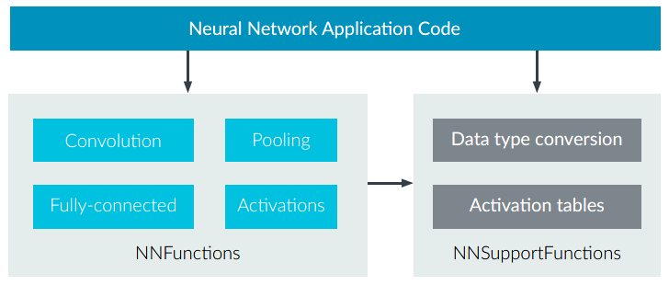
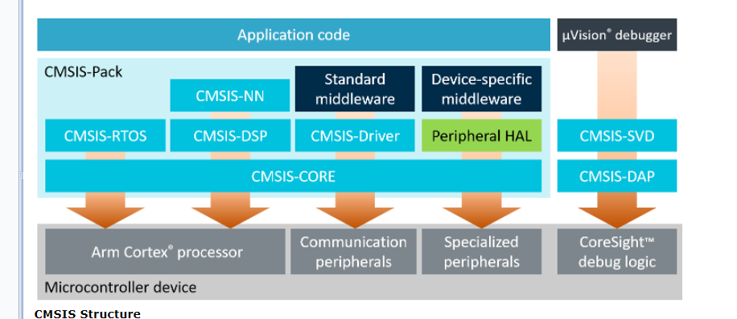
CMSIS-NN - Overview
The Model:
The Interpreter:
The Arm platform:

Slide 24
CMSIS-NN – Overview (Dependencies on CMSIS-CORE)
arm_nnfunctions.h
arm_math.h
Arm Cortex processor
CMSIS-NN functions are declared in arm_nnfunctions.h
CMSIS-DSP functions are declared in arm_math.h
arm_math.h also includes the data-types use in arm_nnfunctions.h
CMSIS-DSP could be compile as an standalone library if we provide an implementation for the functions in arm_math that it uses.

Slide 25
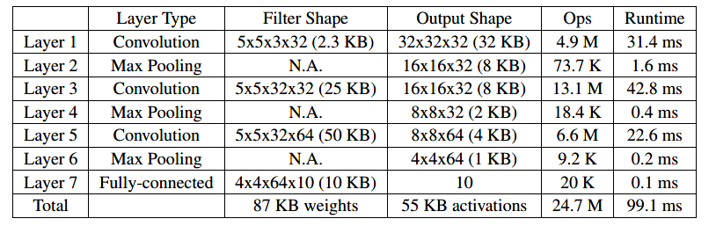
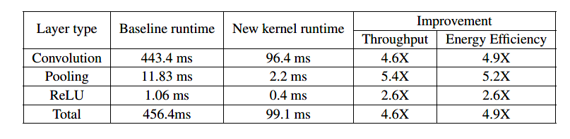
CMSIS-NN - Overview (Performance)
Runtime using Kernels optimized for ARM micros:
Baselie runtime (using ARM non-optimized NN Kernels):

Slide 26
CMSIS-NN - Integration with TFL micro
ML application with trained-model
Host (TensorFlow development Environment)
Target
Micro Interpreter
Build-Scripts
Operations resolver
Kernel
(Interface)
Builder
Compiler
(arm)
Debugger
(gdb-client)
Debugger
(gdb-server)
Reference Kernel
CMSIS-NN Wrapper
Executable
(.elf)
Math
(standard lib)
CMSIS-NN
CMSIS-DSP
Arm-ISS
Microcontroller device
(arm)
TensorFlowLite Micro
Wrapping TFLu access to Arm-NN-Functions
CMSIS-NN (external library imported before building)
Microcontroller-device (e.g. platform includes, linker)

Slide 27
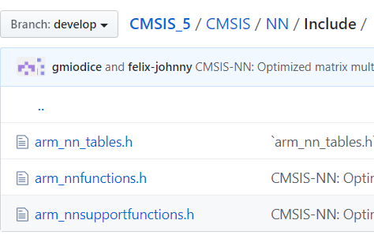
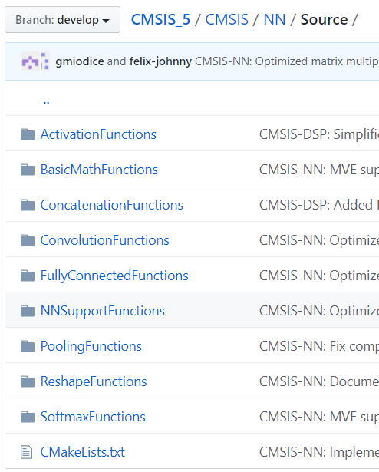
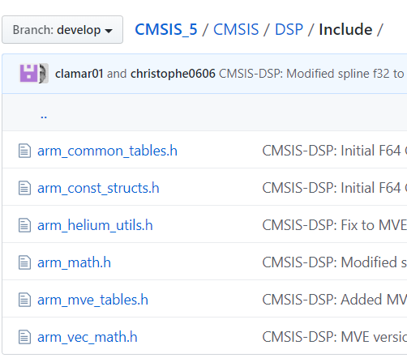
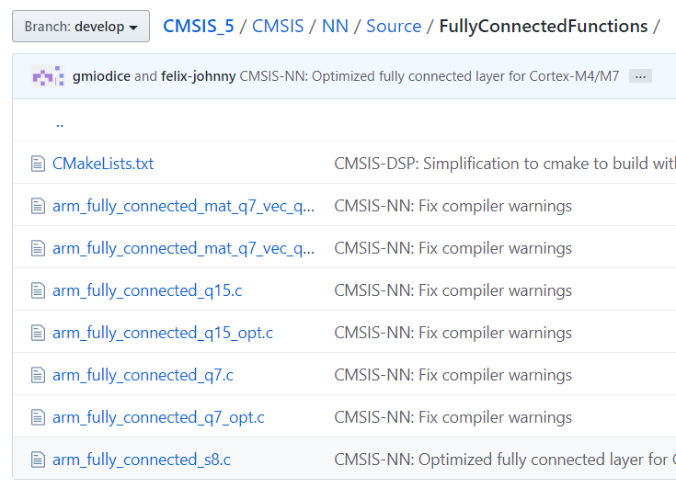
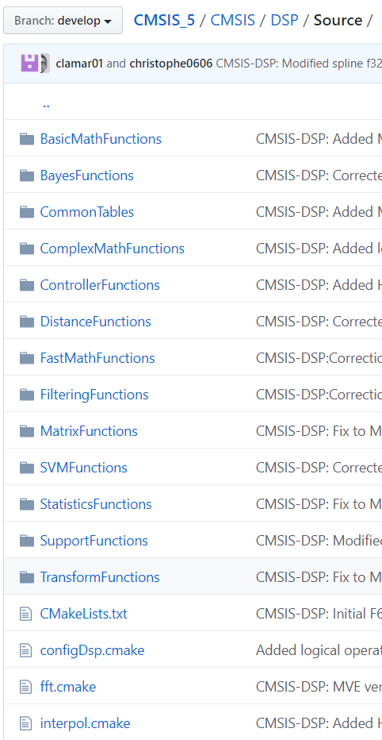
CMSIS-NN - Integration with TFL micro (Direct dependencies on CMSIS)
CMSIS-NN
CMSIS-DSP
Microcontroller device
Microcontroller files, i.e.:
Declaration of data-types needed by both the DSP and the NN libraries.
Function declarations for all DSP functions
Compiler-dependent definitions for special CPU-instructions, e.g.
__SSAT
__SMLAD
/* If defined (ARM_MATH_DSP), takes the
* implementation for Cortex-M4 and M7
*
* An optimized implementation that used
* special instructions, e.g. __SMLAD which
* can perform two signed 16-bit
* multiplications.
*/
/* Implementation for Cortex-M0 and M3 */
for (i = 0; i < num_of_rows; i++)
{
int ip_out = ((q31_t)(bias[i]) << bias_shift) + NN_ROUND(out_shift);
for (j = 0; j < dim_vec; j++)
{
ip_out += pV[j] * pM[i * dim_vec + j];
}
pOut[i] = (q7_t) __SSAT((ip_out >> out_shift), 8);
}
This is done similar for all functions under CMSIS-NN

Slide 28
CMSIS-NN - An alternative approach for RiscV?
Is it worthy to take advantage of the existing CMSIS-NN interface and implement it for IFX-RISCV, using as much as possible from the arm-implementation?
ML application with trained-model
This will require:
1. On Tensor-Flow side:
Add wrapper for IFX’s CMSIS-NN
Extend build system to
Import CMSIS-NN library
Build for RISCV
Connect remotely to ISS
Run acceptance tests provided by TensorFlow (e.g. kernel tests and interpreter tests)
Micro Interpreter
Operations resolver
Kernel
(Interface)
Reference kernel
CMSIS-NN Wrapper
Math
(standard lib)
CMSIS-NN
Generic
2. On CMSIS-NN side:
Set-up a base-repository an project structure
Set-up development environment
Start development and testing of kernel functions.
Generic (it uses no Microcontroller-specific function)
Optimized
Optimized
NN-MATH
Generic
Microcontroller device
Optimized

Slide 29
CMSIS-NN - An alternative approach for RiscV?
HelloWorld_test
Host (TensorFlow development Environment)
Target
Micro Interpreter
Build-Scripts
Operations resolver
Kernel
(Interface)
Builder
Compiler
(riscv)
Debugger
(gdb-client)
Debugger
(gdb-server)
Reference kernel
CMSIS-NN Wrapper
Executable
(.elf)
Math
(standard lib)
CMSIS-NN
NN-MATH
ISS
(SweRV)
Microcontroller device (riscv)
TensorFlowLite Micro
Although we want our CMSIS-NN implementation to be very similar to that of ARM, we also want:
To have a separate library instead of an extension of ARM implementation.
To be independent of CMSIS-DSP, which has many arm-dependencies and include much more from what is needed from CMSIS-NN
Wrapping TFLu access to Arm-NN-Functions
CMSIS-NN (external library imported before building)
Microcontroller-device (e.g. platform includes, linker)

Slide 30
CMSIS-NN - An alternative approach for RiscV? (The base-repository and project structure)
CMSIS_5
Version n
Fork CMSIS_5 repository into IFX_CMSIS
First, focus only on sources for cmsis_nn,
see https://github.com/ARM-software/CMSIS_5/tree/develop/CMSIS
Rename arm into ifxNN? Or just use arm prefix?
Do adjustments (setting precompiler defines) to compile the library for RISCV, as follows:
First, to support for the basic math-operations (e.g. *_fully_connected_q7)
Then, incrementally adding more complex nn-functions, e.g. *_convolve_HWC_q7_basic)
Version n+1
Update CMSIS_NN from community?

Slide 31
CMSIS-NN - An alternative approach for RiscV? (CMSIS-NN structure and dependencies for IFX)
CMSIS-NN
NN-MATH
Microcontroller device
nn_math.h
nn_math.h:
ONLY has to declare the data-types needed by CMSIS-NN.
Support GENERIC implementation:
special CPU-instructions, e.g.__SSAT, shall be implemented in plain C.
/* If defined (ARM_MATH_DSP), takes the
* implementation for Cortex-M4 and M7
*
* An optimized implementation that used
* special instructions, e.g. __SMLAD which
* can perform two signed 16-bit
* multiplications.
*/
/* GENERIC implementation */
for (i = 0; i < num_of_rows; i++)
{
int ip_out = ((q31_t)(bias[i]) << bias_shift) + NN_ROUND(out_shift);
for (j = 0; j < dim_vec; j++)
{
ip_out += pV[j] * pM[i * dim_vec + j];
}
pOut[i] = (q7_t) __SSAT((ip_out >> out_shift), 8);
}
Take the Cortex-M0 and M3 implementation as the default for any target

Slide 32
CMSIS-NN - An alternative approach for RiscV? (CMSIS-NN structure and dependencies for IFX)
In general, we could extend CMSIS/NN/Sources to include optimized implementations for different microcontroller variants, as illustrated below.
RISCV-V1
FullyConnectedFunctions
arm_fullyConnected_q7.c
The build system, could then use a TAG to decide which function to include, e.g.
If TAG = RISCV-V1 then, arm_fullyConnected_q7.c shall be included instead of the reference implementation under CMSIS/NN/Source/FullyConnectedFunctions.
Any other nn-function will be taken from the reference-implementation.

Slide 33
CMSIS-NN - An alternative approach for RiscV? (The development environment)
Acceptance-tests
Host (Our Environment to extend CMSIS-NN)
Target
CMSIS-NN
Builder
(SCons)
Compiler
(gcc, riscv)
Debugger
(GDB-Client)
Debugger
(GDB-Server)
NN-MATH
Executable
(.exe)
Microcontroller device
Build-Scripts
Host
Computer
ISS
(SweRV)
The development toolchain shall allow us to do the following:
Build CMSIS-NN source code and its acceptance-tests
Compile for different targets (e.g. host computer, riscV)
Debug on host-computer and on a target ISS (e.g. SweRV)
Develop and run CMSIS-NN’s acceptance-tests (on host computer and target ISS)
Develop and run unit-tests (on host computer and target ISS).
Perform static-code analysis, code-coverage report, etc
Generate documentation from source code (e.g. Doxygen)
Perform measurements on target ISS (e.g. memory footprint, run-time)
Continuous integration and continuous delivery
EDEN? -> https://confluencewikiprod.intra.infineon.com/display/IFX/.What+is+EDEN+vv1.3.0

Slide 34
CMSIS-NN - An alternative approach for RiscV? (TensorFlowLite Micro and RISCV-nn)
Acceptance-tests
Once everything is in place, we could start with the development, as follows:
On CMSIS-NN side (for every nn-function):
Modify CMSIS-NN sources (CMSIS_5 fork) until it compiles
Adjust NN-MATH functions to compile also for host computer
Adapt CMSIS-NN acceptance-tests to run on host-computer and ISS
Add first unit-tests
Adapt the implementation to pass unit-tests
Generate first documentation
Add first implementations of optimized-math-functions using RISC-V specific instructions
CMSIS-NN
NN-MATH
Microcontroller device
On Tensor-Flow side:
Add wrapper for IFX’s CMSIS-NN
Extend build system to
Import/Download CMSIS-NN library
Build for RISCV
Connect via GDB to ISS
Run acceptance tests provided by TensorFlow (e.g. kernel tests and interpreter tests)

Slide 35
More info
TensorFlow Lite for Microcontrollers | TensorFlow
Get started with microcontrollers | TensorFlow Lite
Understand the C++ library | TensorFlow Lite
TensorFlow Lite converter | TensorFlow
TensorFlow tensors
TensorFlow Lite 8-bit quantization specification
https://nervanasystems.github.io/distiller/algo_quantization.html
https://github.com/google/gemmlowp/blob/master/doc/quantization.md#implementation-of-quantized-matrix-multiplication

